Slide 1
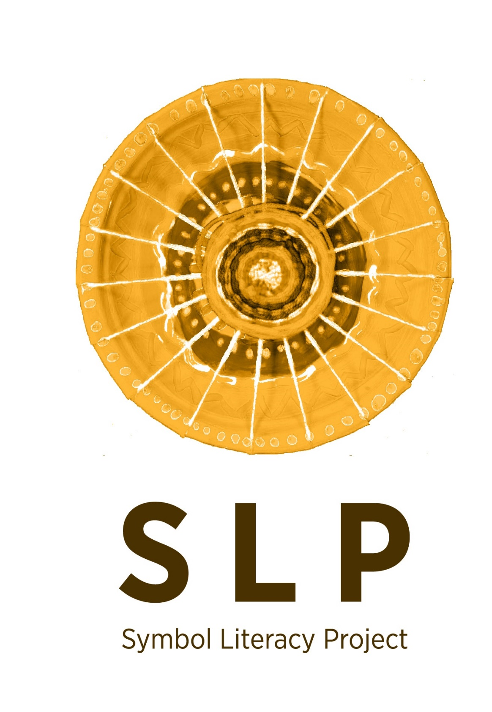

Slide 2
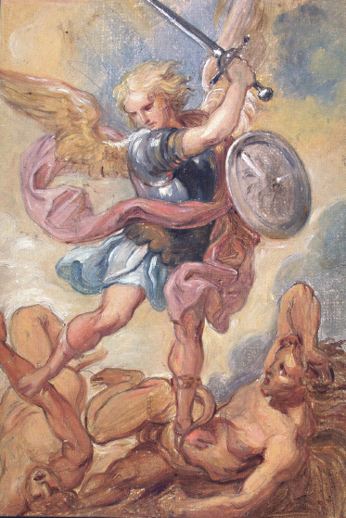
Symbol Literacy Project
A 17th century piece of art, painted in the tradition of the Flemish school depicting St Michael Archangel defeating two devils.
Even though it’s is a comparatively small painting (24cm x 34cm) it is full of vibrant colours, movement and vitality

Slide 3
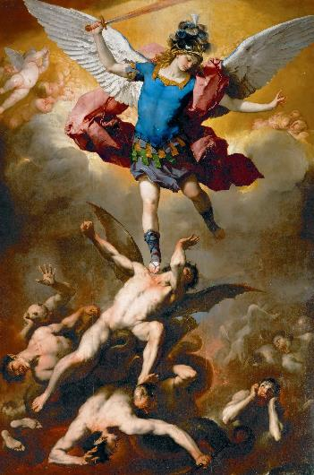
Symbol Literacy Project
Archangel Saint Michael, is honoured in Christian, Jewish and Muslim traditions. According to legend, after the creation, Lucifer, the "light-bearer", rebelled against God. Because of his envy, pride, and desire to sit upon God's throne, Lucifer did not want to serve God. He took a third of the angels into revolt with him. Michael, however, was loyal to God, and declared he would serve God, for "who is like God?" (in Hebrew: "Mikha’el"). With the other two-thirds of the angels he defeated Lucifer and cast him and his supporters out of heaven. Lucifer now became called Satan ("adversary") and those angels who supported him became devils.

Slide 4
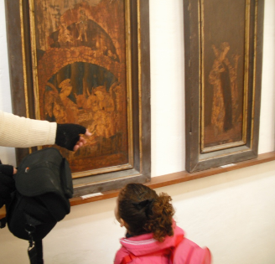
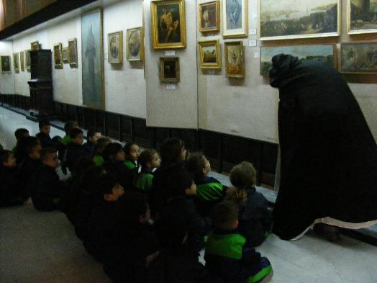
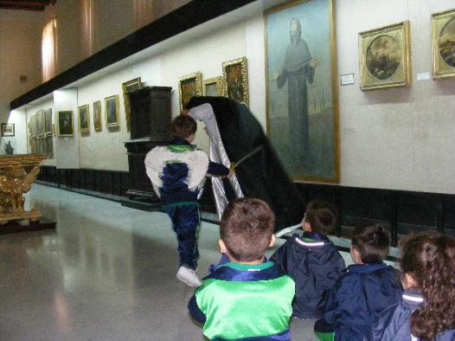
Symbol Literacy Project
The Activity
Learning to observe
Listening to the story
Role-play

Slide 5
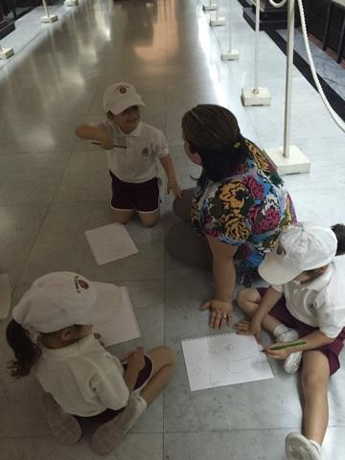
Symbol Literacy Project
The Activity
Allowing time for processing through drawing and story development

Slide 6
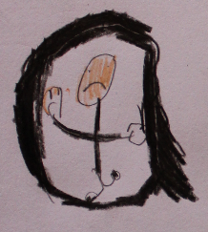
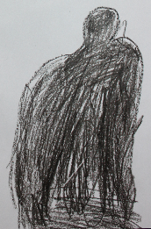
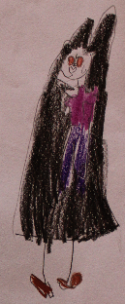
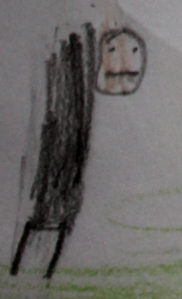
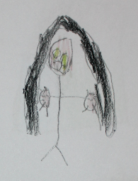
Symbol Literacy Project
Four main ways how children depicted the “bad guy”

Slide 7
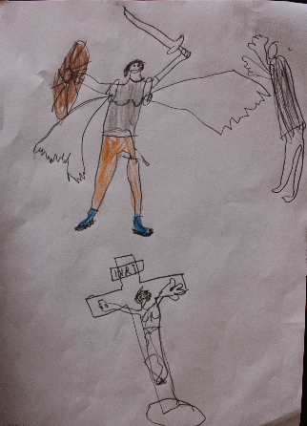
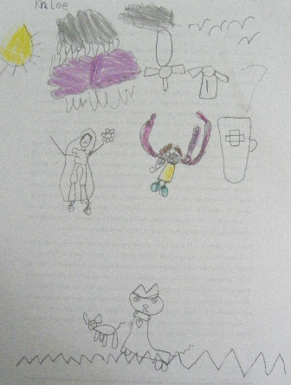
Symbol Literacy Project
The concepts of protection + fighting to defend the weak are particularly evident in these two exemplars
The girl takes it a step further by identifying herself as the good angel ‘soldier’
5 yr old Boy
5 yr old Girl

Slide 8
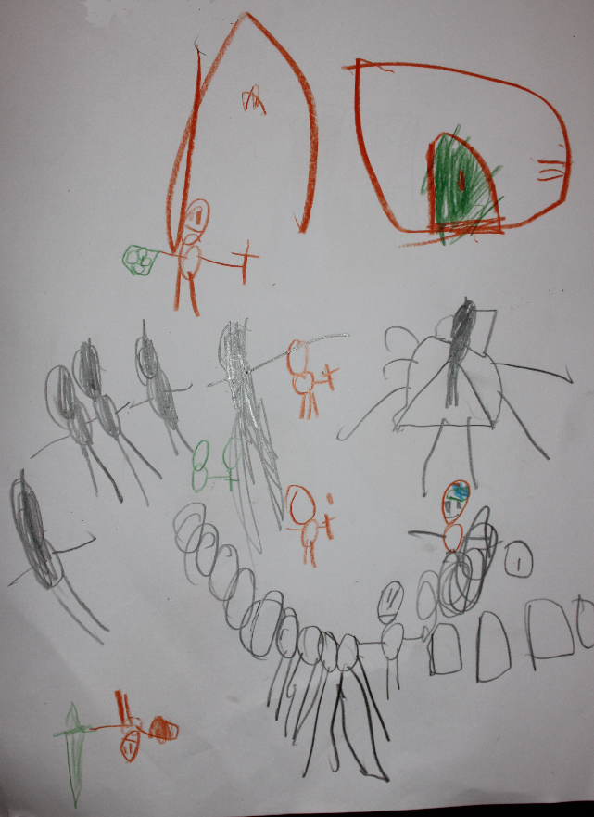
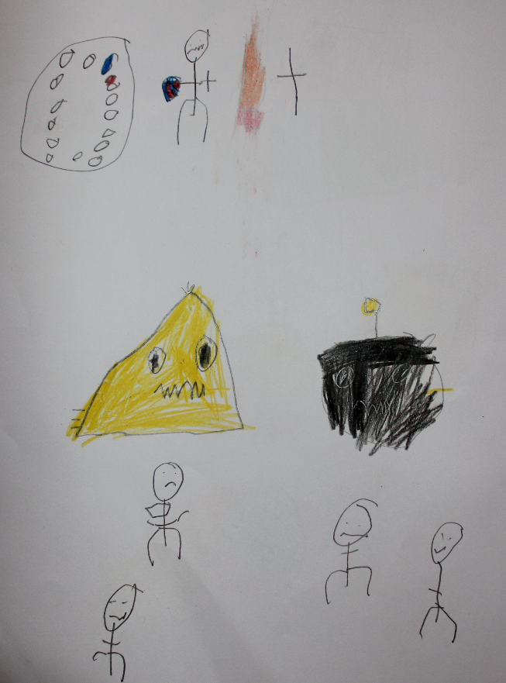
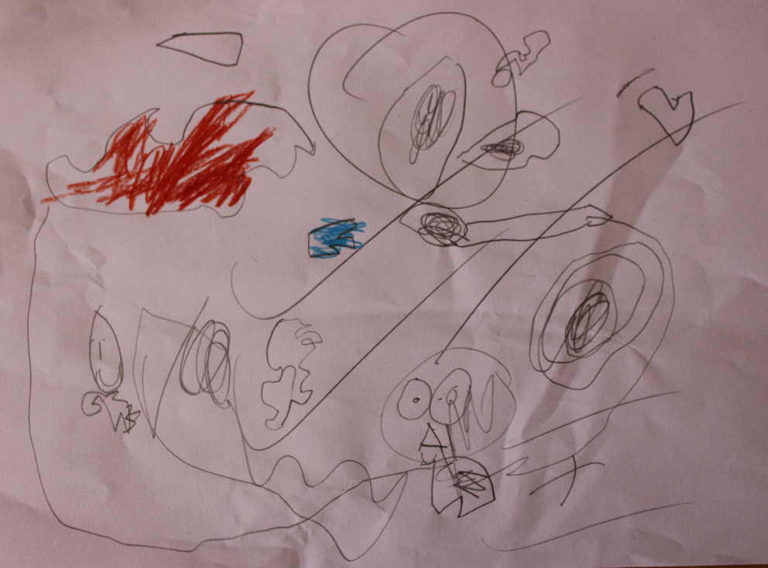
Symbol Literacy Project
Children’s ability to transfer the same concepts to different situation by using different characters

Slide 9
Symbol Literacy Project
For further reading
Gellel, A. M., Deguara, J., & Formosa, J. (2024). Supporting young children’s metaphorical engagement through a Symbol Literacy Approach. Journal of Early Childhood Research, 1476718X241231671.

